Slide 1

Data Analytics An Overview
Husain Rangwala
24th February 2021
Professor Zhi He
ALY6000 – Introduction to Data Analytics

Slide 2
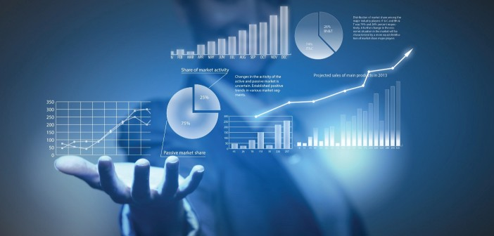

Data Analyst
In today’s market, data is more valuable than oil. [2]
Every interaction a user makes with the internet produces huge and continuous volume of information. This data is only one half. The second half involved building new products that use the data. To accomplish this various machine learning and algorithm are developed to predict what information a user would find valuable.[1]
In the technological driven world where information through Increase in Connected Devices, Increase in Data Generation, Ease of Access, Customer Needs and Marketing , Data-Driven Decision-Making are easily generated than organizations who could make any sense of it . This has made requirement of skill personal who could analyze the data and compiled smarter data and analytics best practices into a customizable roadmap. [3]
Chart 1 : Data Storage and modeling from
“https://towardsdatascience.com/why-data-analytics-is-gaining-hype-in-the-21st-century-b7b1ca289f09”
Chart 2: Data as grouped information from
“https://www.bioenergyconsult.com/data-science-new-emergence/“

Slide 3
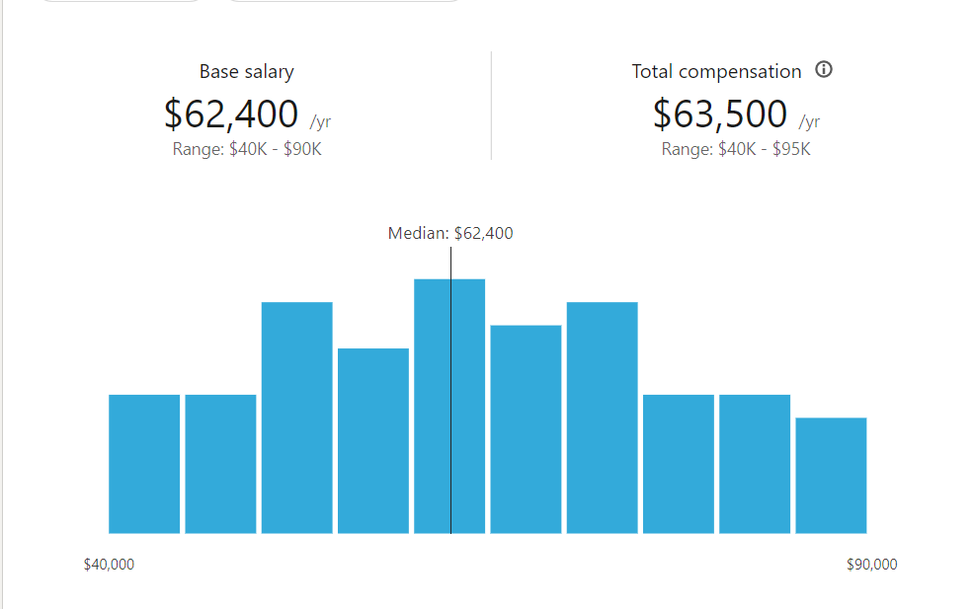
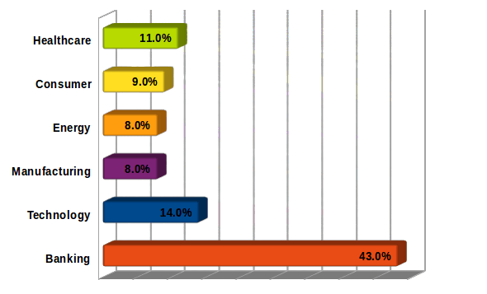
What fields can a Data Analyst work?
Chart 3 : Average Salary as per LinkedIn
“https://www.linkedin.com/salary/data-analyst-salaries-in-united-states”
Chart 4 : Fields where Data analyst can work
“https://www.edureka.co/blog/10-reasons-why-big-data-analytics-is-the-best-career-move”

Slide 4

Data Scientist
Data scientists are big data wranglers, gathering and analyzing large sets of structured and unstructured data
Data scientists are analytical experts who utilize their skills in both technology and social science to find trends and manage data.
They design data modeling processes, create algorithms and predictive models to extract the data the business needs, and help analyze the data and share insights

Slide 5
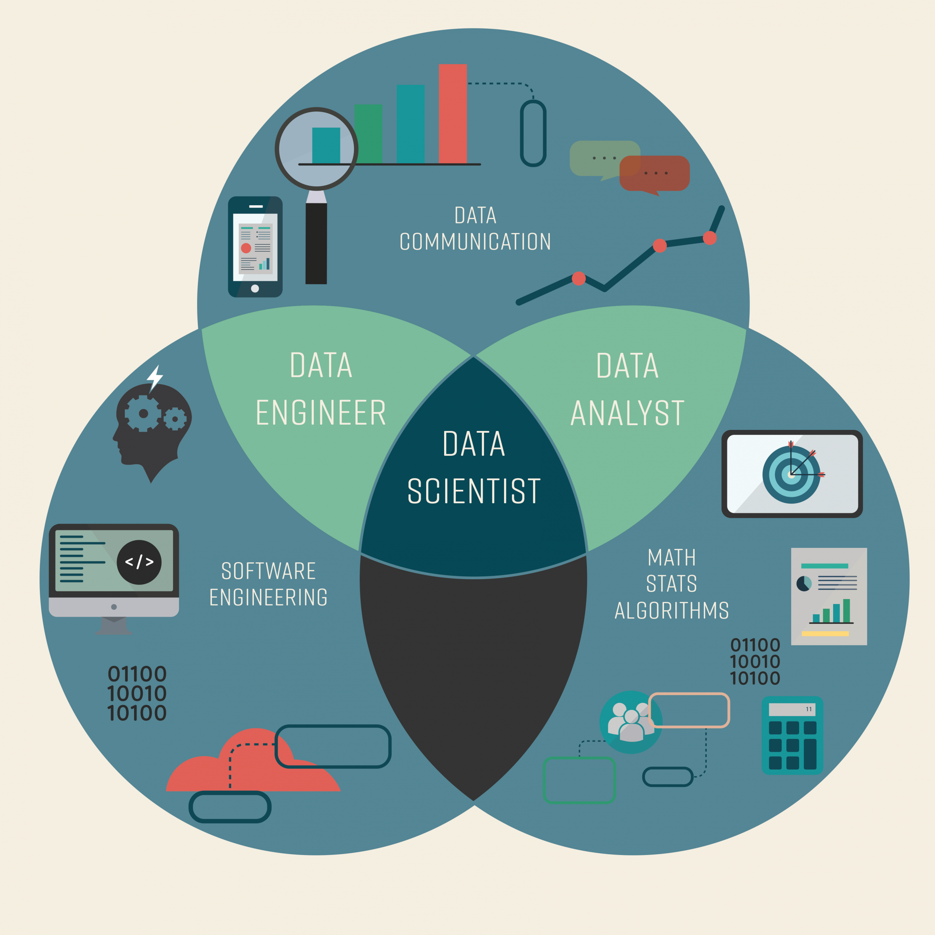
Job roles
Ask the right questions to begin the discovery process
Acquire data
Process and clean the data
Integrate and store data
Initial data investigation and exploratory data analysis
Choose one or more potential models and algorithms
Apply data science techniques, such as machine learning, statistical modeling, and artificial intelligence
Measure and improve results
Present result to stakeholders
Adjust based on feedback
Repeat the process to solve a new problem
Chart 6 : Data Science cycle from
“https://www.mydatacareer.com/datascienceskills”

Slide 6
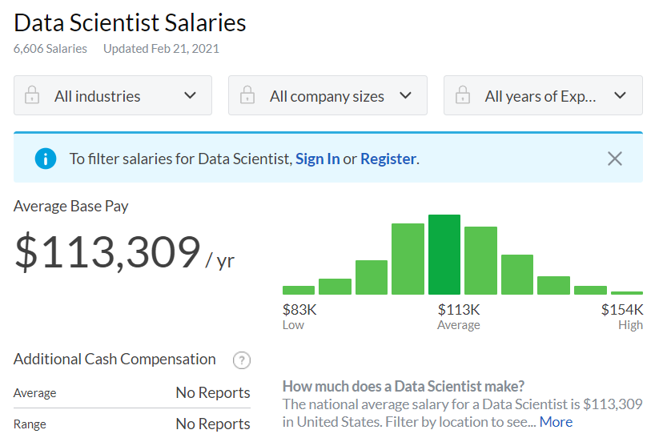
Skills and salary for Data Scientist
6
Fundamentals of Data Science
Statistics
Programming knowledge
Data Manipulation and Analysis
Data Visualization
Machine Learning
Deep Learning
Big Data
Software Engineering
Model Deployment
Communication Skills
Storytelling Skills
Structured Thinking
Curiosity
Chart 7: Data Scientist Salaries
“https://www.glassdoor.com/Salaries/data-scientist-salary-SRCH_KO0,14.htm”

Slide 7
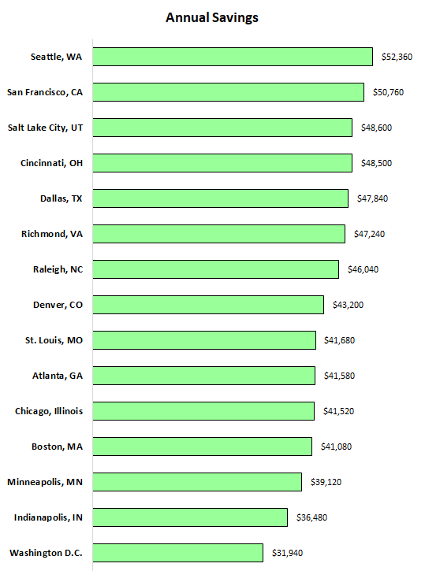
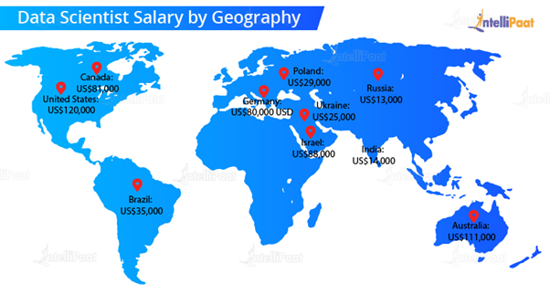
Market demands
7
Chart 8: Data Scientist salary by county
https://intellipaat.com/blog/how-much-does-a-data-scientist-earn/
Chart 9 : Data Scientist salary by Cities in United States
“https://fourpillarfreedom.com/comparing-data-scientist-salaries-and-cost-of-living-in-different-u-s-cities/”

Slide 8

References
https://knowledge.wharton.upenn.edu/article/whats-driving-demand-data-scientist/
https://towardsdatascience.com/why-data-analytics-is-gaining-hype-in-the-21st-century-b7b1ca289f09
https://www.purdueglobal.edu/blog/information-technology/rise-of-data-analyst/
https://www.pwc.com/us/en/library/data-science-and-analytics.html
https://datasciencedegree.wisconsin.edu/data-science/data-scientist-salary/
https://www.linkedin.com/salary/data-analyst-salaries-in-san-francisco-bay-area?isQueryParams=true
https://www.bioenergyconsult.com/data-science-new-emergence/
“https://www.edureka.co/blog/10-reasons-why-big-data-analytics-is-the-best-career-move
https://businessoverbroadway.com/2018/04/08/salaries-of-data-scientists-and-machine-learning-engineers-from-around-the-world
https://www.cio.com/article/3292983/what-is-a-data-engineer.html
https://businessoverbroadway.com/2018/04/08/salaries-of-data-scientists-and-machine-learning-engineers-from-around-the-world
“https://towardsdatascience.com/data-engineer-vs-data-scientist-bc8dab5ac124

Slide 9
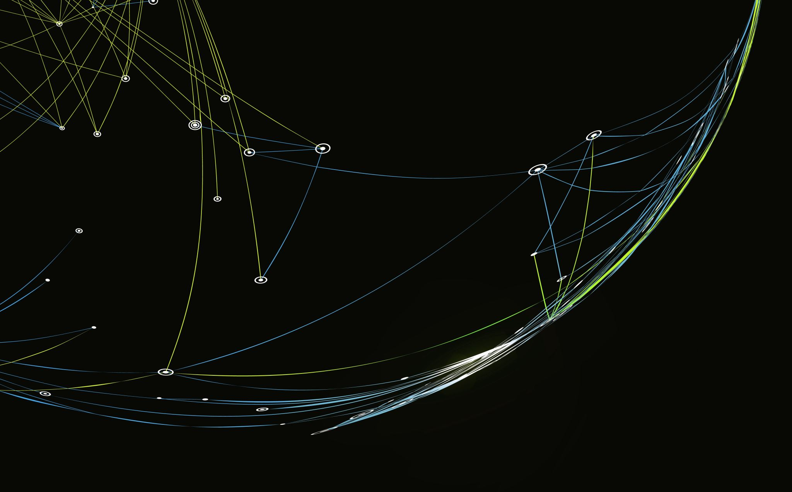
Questions

